Slide 1
Mining Social-Network Graphs
Jaya Sil

Slide 2
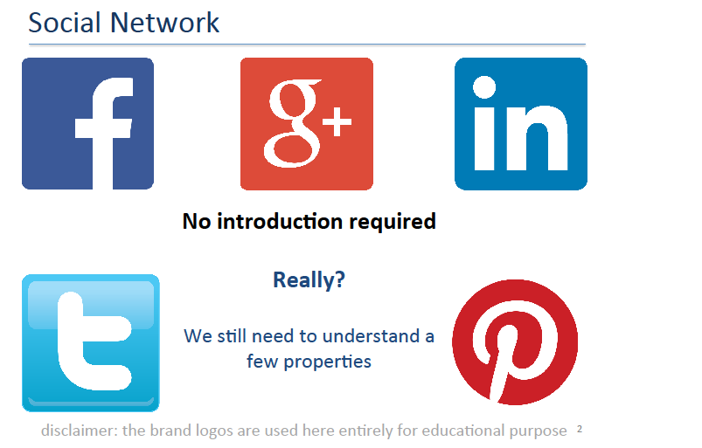
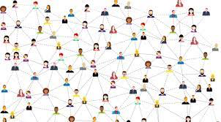
Social Networks as Graphs
Social networks by introducing a graph model.
“locality,” the property of social networks says nodes and edges of the graph tend to cluster in communities.

Slide 3
The characteristics of a social network
There is a collection of entities that participate in the network, typically people.
There is at least one relationship between the entities of the network.
For example: friends
– Sometimes boolean: two people are either friends or they are not
– May have a degree
– Discrete degree: friends, family, acquaintances, or none
– Degree – real number: the fraction of the average day that two people spend talking to each other.

Slide 4
Social graph
An assumption of locality.
If entity A is related to both B and C, then there is a higher probability than average that B and C are related.
Social networks are naturally modeled as graphs, refer to as a social graph.
The entities are the nodes, and an edge connects two nodes if the nodes are related by the relationship that characterizes the network.
If there is a degree associated with the relationship, this degree is represented by labeling the edges.

Slide 5
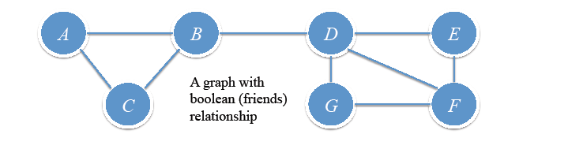
Is this graph typical of a social network, does it exhibit locality of relationships?
The graph has nine edges out of the ⁷C₂ = 21 pairs of nodes that
could have had an edge between them.
Suppose
X, Y, and Z are nodes, with edges between X and Y and X and Z.
What is the probability that Y and Z form an edge?

Slide 6
Social Graph
If the graph were large, that probability would be very close to the fraction of the pairs of nodes that have edges between them, i.e., 9/21 = 0.429 in this case.
However, because the graph is small, there is a noticeable difference between the true probability and the ratio of the number of edges to the number of pairs of nodes.
Since we already know there are edges (X, Y ) and (X, Z), therefore, only seven edges remaining.
Those seven edges could run between any of the 19 remaining pairs of nodes.
Thus, the probability of an edge (Y, Z) is 7/19 = 0.368.

Slide 7
Now, we compute the probability that the edge (Y, Z) exists, given that edges (X, Y ) and (X, Z) already exist.
If X is A, then Y and Z must be B and C, in some order.
Since the edge (B,C) exists, A contributes one positive example (where the edge does exist) and no negative examples (where the edge is absent).
The cases where X is C, E, or G are essentially the same.
In each case, X has only two neighbors, and the edge between the neighbors exists.
Thus, we have seen four positive examples and zero negative examples so far.

Slide 8
Consider X = F, three neighbors, D, E, and G and edges exist between two of the three pairs of neighbors, but no edge between G and E.
So two more positive examples and one negative example.
If X = B, three neighbors, but only one pair of neighbors, A and C, has an edge.
Thus, we have two more negative examples, and one positive example, for a total of seven positive and three negative.
Finally, when X = D, there are four neighbors. Of the six pairs of neighbors, only two have edges between them.

Slide 9
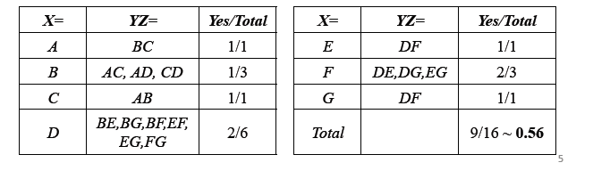
Thus, the total number of positive examples is nine and the total number
of negative examples is seven.
The fraction of times the third edge exists is thus 9/16 = 0.563, considerably greater than 0.368, expected value for that fraction.
The Fig. exhibits the locality expected in a social network.

Slide 10
Varieties of Social Networks
Telephone Networks - the nodes represent the phone numbers of individuals.
There is an edge between two nodes if a call has been placed between those phones in some fixed period of time, such as last month, or “ever.”
The edges could be weighted by the number of calls made between these phones during the period.
Communities in a telephone network will form from groups of people that communicate frequently: groups of friends, members of a club, or people working at the same company, for example.

Slide 11
Email Networks
The nodes represent email addresses of individuals.
An edge represents the fact that there was at least one email in at least one direction between the two addresses.
Another approach is to label edges as weak or strong.
Strong edges represent communication in both directions, while weak edges indicate communication in one direction.
The communities seen in email networks come from the same sorts of groupings.
A similar sort of network involves people who text other people through their cell phones.

Slide 12
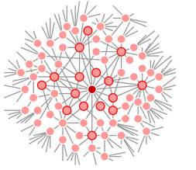
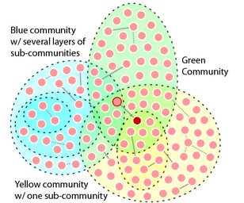
Structure of Social Network
Everyone has their own social
network
Communities are held together by common interest. It may be a hobby,

Slide 13
Communities
Social networks contain communities of entities that are connected by many edges.
Groups of friends at school or groups of researchers interested in the same topic.
We consider clustering of the graph as a way to identify the communities.
For applying standard clustering techniques to a social-network graph, first to define a distance measure.
In Edge labeled graphs, labels might be usable as a distance measure, depending on what they represent.

Slide 14
Assume that nodes are close if they have an edge between them and distant if not.
We could say that the distance d(x, y) is 0 if there is an edge (x,y) and 1 if there is no such edge.

Slide 15
Standard Clustering Methods
Two communities {A, B, C} and {D, E, F, G}.
{D,E,F} and {D,F,G} are two subcommunities of
{ D, E, F, G};
These two subcommunities overlap in two of their members, and thus could never be identified by a pure clustering algorithm.

Slide 16
Standard Clustering Methods
The problem with hierarchical clustering is that at some point we are likely to chose to combine B and D, even though they surely belong in different clusters.
We try a k-means approach to clustering with k = 2.
If we pick two starting nodes at random, they might both be in the same cluster.
We start with one randomly chosen node and then pick another as far away as possible, though not solve the problem.
We could thereby pick any pair of nodes not connected by an edge, e.g., E and G but difficult to find in large graph.

Slide 17
Traditional clustering
Traditional clustering depends on the distance – Likely to put two nodes with small distance in the same cluster
– Social network graphs would have cross-community edges
May join B and D (and hence the two communities) with not so low probability

Slide 18
Betweenness of an Edge
Several specialized clustering techniques have been developed to find communities in social networks.
The edge betweenness centrality is defined as the number of the shortest paths that go through an edge in a graph or network
Betweenness of an edge AB: #of pairs of nodes (X,Y) such that AB lies on the shortest path between X and Y
– There can be more than one shortest paths between X and Y
– Credit AB the fraction of those paths which include the edge AB

Slide 19
Betweenness
High score of betweenness means? – The edge runs “between” two communities
Betweenness gives a better measure – Edges such as BD get a higher score than edges such as AB
In fact, this edge is on every shortest path between any of A, B, and C to any of D, E, F, and G.
Not a distance measure, may not satisfy triangle inequality. Doesn’t matter!

Slide 20
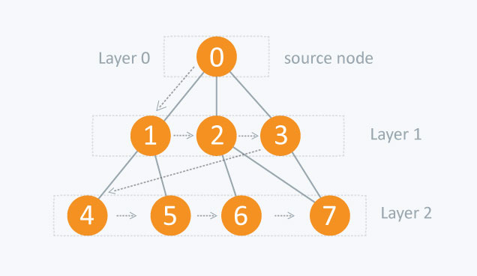
BFS is a traversing algorithm, start traversing from the starting node and traverse the graph layerwise thus exploring the neighbour nodes (nodes which are directly connected to source node).
Then move towards the next-level neighbour nodes.
As the name BFS suggests, you are required to traverse the graph breadthwise as follows:
First move horizontally and visit all the nodes of the current layer
Move to the next layer

Slide 21
Girvan-Newman (GN) Algorithm
We need to calculate the number of shortest paths going through each edge for exploiting betweenness of edges.
Girvan-Newman (GN) Algorithm visits each node X once and computes the number of shortest paths from X to each of the other nodes that go through each of the edges.
The algorithm begins by performing a breadth-first search (BFS) of the graph, starting at the node X.
The level of each node in the BFS presentation is the length of the shortest path from X to that node. So, the edges that go between nodes at the same level can never be part of a shortest path from X.

Slide 22
Edges between levels are called DAG edges (“DAG” stands for directed, acyclic graph).
Each DAG edge will be part of at least one shortest path from root X.
If there is a DAG edge (Y,Z), where Y is at the level above Z (i.e., closer to the root), then we shall call Y a parent of Z and Z a child of Y.
First Step: Starting at node E. Gray edges are DAG edges and blue edges connect nodes at the same level.

Slide 23
Breadth-first presentation of the graph, starting at node E.
E 1
Level 1 D 1 F 1
Level 2 B 1 G 2
Level 3 1 C 1
The second step of the GN algorithm is to label each node by the number of shortest paths that reach it from the root. Start by labeling the root 1. Then, from the top down, label each node Y by the sum of the labels of its parents.
A

Slide 24
First, label the root E with 1.
At level1 are the nodes D and F.
Each has only E as a parent, so they too are labeled 1.
Nodes B and G are at level 2.
B has only D as a parent, so B’s label is the same as the label of D, which is 1.
However, G has parents D and F, so its label is the sum of their labels, or 2.
Finally, at level 3, A and C each have only parent B, so their labels are the label of B, which is 1.

Slide 25
The third and final step
Calculate for each edge e the sum over all nodes Y of the fraction of shortest paths from the root X to Y that go through e.
This calculation involves computing this sum for both nodes and edges, from the bottom.
Each node other than the root is given a credit of 1, representing the shortest path to that node.
This credit may be divided among nodes and edges above, since there could be several different shortest paths to the node.

Slide 26
The rules for credit calculation
Each leaf in the DAG gets a credit of 1.
2. Each node that is not a leaf gets a credit equal to 1 plus the sum of the credits of the DAG edges from that node to the level below.
3. A DAG edge e entering node Z from the level above is given a share of the credit of Z proportional to the fraction of shortest paths from the root to Z that go through e.

Slide 27
Formally, let the parents of Z be Y₁,Y₂,...,Y_{k}.
Let p_{i} be the number of shortest paths from the root to Y_{i};
This number was computed in Step 2 .
Then the credit for the edge (Y_{i}, Z) is the credit of Z times p_{i} divided by 􏰄Σ p_{j} where j varies from 1 to k.
After performing the credit calculation with each node as the root, we sum the credits for each edge.
Since each shortest path will have been discovered twice – once when each of its endpoints is the root – we must divide the credit for each edge by 2.

Slide 28
First, A and C, being leaves, get credit 1. Each of these nodes have only one parent, so their credit is given to the edges (B, A) and (B, C), respectively.
E
D F
B 3 G 1
1 1
1 1 C
A
At level 2, G is a leaf, so it gets credit 1. B is not a leaf, so it gets credit equal to 1 plus the credits on the DAG edges entering it from below. Since both these edges have credit 1, the credit of B is 3. Intuitively 3 represents the fact that all shortest paths from E to A, B, and C go through B.

Slide 29
Completing the credit calculation
B has only one parent, D, so the edge (D, B) gets the entire credit of B, which is 3.
G has two parents, D and F, therefore need to divide the credit of 1 that G has between the edges (D, G) and (F, G).
In what proportion do we divide?
If you examine the labels, you see that both D and F have label 1, representing the fact that there is one shortest path from E to each of these nodes.
Thus, we give half the credit of G to each of these edges; i.e., their credit is each 1/(1 + 1) = 0.5.

Slide 30
Had the labels of D and F been 5 and 3, meaning there were five shortest paths to D and only three to F , then the credit of edge (D, G) would have been 5/8 and the credit of edge (F, G) would have been 3/8.

Slide 31
Now, we can assign credits to the nodes at level 1.
D gets 1 plus the credits of the edges entering it from below, which are 3 and 0.5.
That is, the credit of D is 4.5.
The credit of F is 1 plus the credit of the edge (F, G), or 1.5.
Finally, the edges (E, D) and (E, F ) receive the credit of D and F, respectively, since each of these nodes has only one parent.
The credit on each of the edges is the contribution to the be- tweenness of that edge due to shortest paths from E.
For example, this contribution for the edge (E, D) is 4.5.

Slide 32
To complete the betweenness calculation, we have to repeat this calculation for every node as the root and sum the contributions.
Finally, we must divide by 2 to get the true betweenness, since every shortest path will be discovered twice, once for each of its endpoints.

Slide 33
Computation in Practice
Complexity: n nodes, e edges – BFS starting at each node: O(e) – Do it for n nodes – Total: O(ne) time
– Very expensive
Method in practice – Choose a random subset W of the nodes – Compute credit of each edge starting at each node in W – Sum and compute betweenness – A reasonable approximation

Slide 34
Using Betweenness to Find Communities
The betweenness scores for the edges of a graph behave something like a distance measure on the nodes of the graph.
We can cluster by taking the edges in order of increasing betweenness and add them to the graph one at a time.
At each step, the connected components of the graph form some clusters.
The higher the betweenness we allow, the more edges we get, and the larger the clusters become.

Slide 35
Finding Communities using Betweenness
Method 1:
Keep adding edges (among existing ones) starting from lowest betweenness
Gradually join small components to build large connected components

Slide 36
Method 2:
Start from all existing edges. The graph may look like one big component.
Keep removing edges starting from highest betweenness
Gradually split large components to arrive at communities
More commonly, this idea is expressed as a process of edge removal.

Slide 37


At some point removing the edge with highest betweenness would split the graph into separate counter

Slide 38
Betweenness scores for the graph
5
12
4.5
Edge (B,D) has the highest betweenness, so it is removed first.
That leaves us with exactly the communities: {A, B, C} and {D, E, F, G}.
Continue to remove edges. Next to leave are (A, B) and (B, C) with a score of 5, followed by (D, E) and (D, G) with a score of 4.5. Then, (D, F ), whose score is 4, would leave the graph.
5
4
4.5
1.5
1
1.5

Slide 39
All the edges with betweenness 4 or more have been removed
D E
C G F
A
B
A and C are more closely knit to each other than to B.
Likewise, E, F, and G remain connected.

Slide 40
Finding Communities using Betweenness
For a fixed threshold of betweenness, both methods would ultimately produce the same clustering
However, a suitable threshold is not known beforehand
Method 1 vs Method 2
– Method 2 is likely to take less number of operations. Because Inter-community edges are less than intra-community edges

Slide 41
Triangles in Social Network Graph
Number of triangles in a social network graph is expected to be much larger than a random graph with the same size.
– The locality property
Counting the number of triangles
– How much the graph looks like a social network
– Age of community • A new community forms • Members bring in their like minded friends
• Such new members are expected to eventually connect to other members directly

